Slide 1
Electrical Load Characteristics of Domestic Heat Pumps and Scope for Demand Side Management
Peter Boait
Institute of Energy & Sustainable Development
De Montfort University
Leicester, UK
Boait– UK – S4 – 0125

Slide 2
Heat Pumps – key to decarbonisation of domestic heating in UK
Approx. 1.5M homes with electrical space heating
Thermal storage heaters with timed electrical load for demand management – « Economy 7 »
Renewable Heat Incentive introduced
Subsidy to heat pump capital cost now and may offer in 2012 a « feed-in tariff ».
Boait– UK – S4 – 0125

Slide 3
Study Questions
Heat pumps will replace thermal storage – what is the shape of their daily demand profile?
Loss of demand management – can it be replaced?
Boait– UK – S4 – 0125

Slide 4
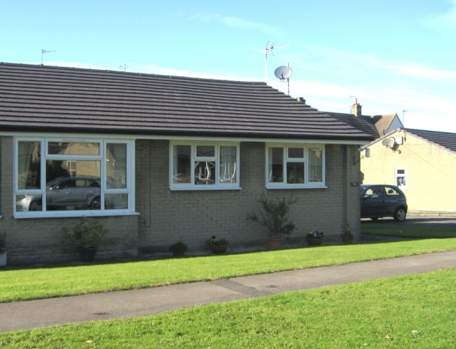
Detailed study of heat pump performance in a group of 10 homes
Small dwellings – 70 m²
Occupants mainly older people
6kW peak IVT ground source heat pumps
Boait– UK – S4 – 0125

Slide 5
Average heat pump Coefficient of Performance (CoP)
SPF = Seasonal Performance Factor
Boait– UK – S4 – 0125

Slide 6
Seasonal breakdown of total electricity consumption
DHW = Domestic Hot Water
Boait– UK – S4 – 0125

Slide 7
Daily profile of heat pump electricity demand
Boait– UK – S4 – 0125

Slide 8
Distribution of hot water use during the day
DHW = Domestic Hot Water
Boait– UK – S4 – 0125

Slide 9
Opportunities for demand management – hot water storage
190 litre hot water tank provides energy storage
Hot water heating could be brought forward by 10 hours with losses < 10% (0.5kWh)
Tariff (and CO2) reduction must compensate for losses
A « Smart » response by the heat pump control system to a time of day tariff is essential
Boait– UK – S4 – 0125

Slide 10
Opportunities for demand management – space heating
Some heat pump installations have a buffer tank for space heating
High thermal mass house 5-10kWh/ºC
When well insulated 1-3 hour gap in heating will result in room temperature loss < 1ºC
So can smooth early evening peak demand
Boait– UK – S4 – 0125

Slide 11
Conclusions
Profile of heat pump demand over 24 hours tends to be flat with peaks due to hot water use.
Demand side management is possible, exploiting energy storage in hot water tanks and building fabric.
Smart control unit in the home and profiled time of day tariffs essential
p.boait@dmu.ac.uk
Boait– UK – S4 – 0125

