Slide 1
Klatt, Matthias
Meyer, Jan
Schegner, Peter Technische Universitaet Dresden
Backes, Jürgen
Li, Ran EnBW Regional AG, Stuttgart
Power quality aspects of rural grids with high penetration of microgeneration, mainly PV installations
Paper-ID: 0273

Slide 2
Goals of the survey
Analysis of influence of micro generation units (mainly PV) on voltage and current quality
Voltage quality
Distortion levels in the grid
EN 50160 compliance
Prevailing high frequency distortion levels
Current quality
Emission levels of self-commutated inverters
Selection of measured networks
→ In cooperation with german DNO
→ With large number of PV installations

Slide 3
Grid description
Rural area
20 kV MV ring
51 LV grids
>180 PV installations
>2 MW installed PV power
>1600 supply points
Similar consumer topology for all LV grids
Limited number of measurement units: 3
Where to measure?

Slide 4
LV grid characteristics
S_{SC} influences power quality
Results from network calculation software
Upper limits mainly determined by transformer
Low influence from upstream grid
28% supply points with
S_{SC}< S_{SC ref}
Short circuit power S_{SC} / MVA
160 kVA
Grid #
S_{SC ref} → S_{SC} at reference impedance

Slide 5
Main goals of site selection
1. Impact of PV installations
Without PV installation (as reference)
With PV installations
2. Summation effect: Does a 10 kVA PV installation have the same effect
as 10x 1 kVA PV installations?
3. Power scaling effect:
Do 10x 1 kVA PV installations have a 10x greater effect
than a 1 kVA PV installation?
4. Propagation:
How does the emission propagate into the grid?

Slide 6
Power output of PV units
Grid without PV
Later 25 kW PV installed
3 Customers (Farms)
160 kVA Transformer
2 tuesdays during summer
Generation between 7am and 7pm
Reactive power virtually not affected

Slide 7
Comparison of spectrum up to 5 kHz
Virtually no difference in spectrum for voltage and current
Similar results for day/night
Possible explanations:
PV power too low
Measured frequency range too narrow
Inverters too far away from measurement (damping)
No emissions from PV

Slide 8
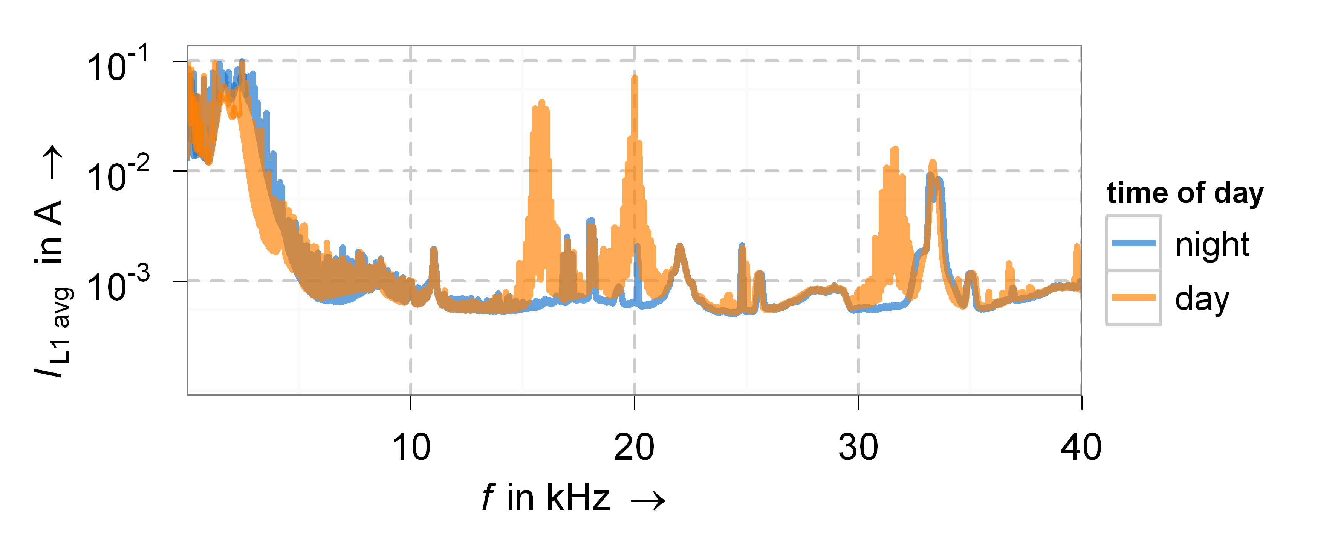
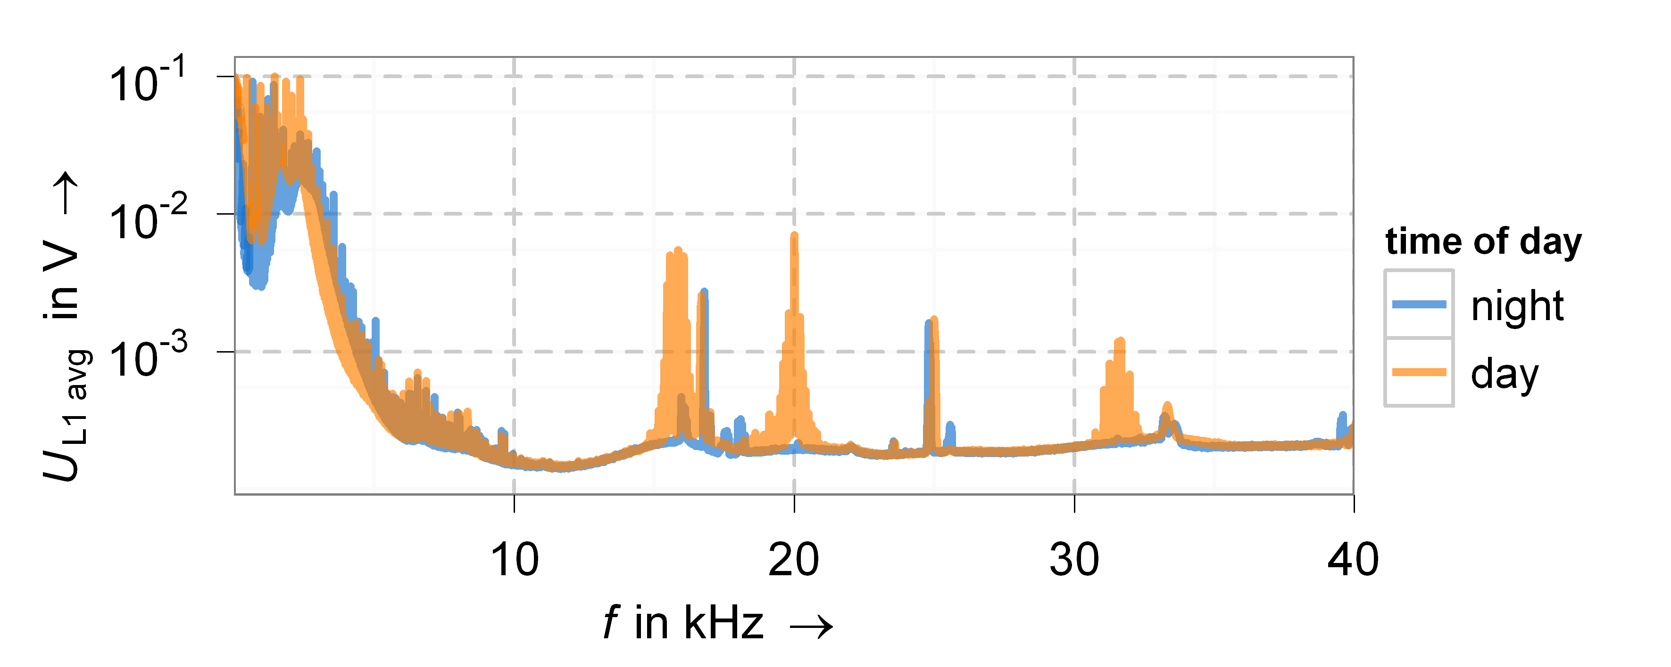
Extended frequency range up to 40 kHz (1)
Difference Day/Night
During day:
Emissions at 16 kHz and 20 kHz
Additional components at 32 kHz and 40 kHz
Source: probably PV inverters
Still very low distortion levels
Emissions above 9 kHz
Verification in different grids
0.04%
0.004%
0.0004%

Slide 9
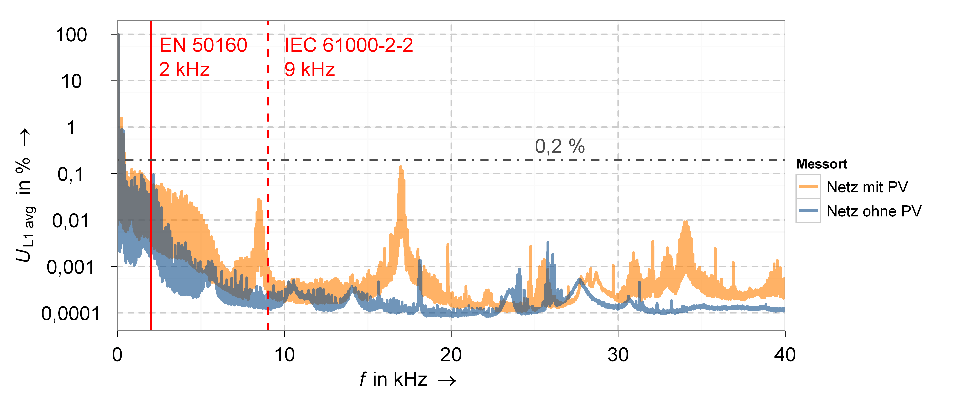
Extended frequency range up to 40 kHz (2)
Highest emission at 17 kHz
Range up to 2 kHz / 9 kHz in standards is insufficient
Recommended compatibility levels 0,2% nearly reached
Measurement site
Grid with high PV
Grid without PV

Slide 10
Summary and future work
Modern inverters: shift of emission to higher frequency range
Emission at frequencies significantly higher than 9 kHz
➔ Measurement up to 50 kHz recommended
Voltage distortion levels still low but increasing
Continuing measurements at additional sites
Additional measurement sites in line with goals
Analysis of high frequency current propagation
Start of an additional project with similar goals
(26 measurement units)

Slide 11
Thank you for your attention !
Contact details:
Matthias Klatt Technische Universität Dresden Institute of Electrical Power Systems and High Voltage Engenieering 01062 Dresden
tel. +49-351-463 35223 fax. +49-351-463 37036
email: matthias.klatt@tu-dresden.de

