Slide 1
Characteristics of the Input Current of ESLs and their Impact on Power Quality
Johannes Ferstl
Herwig Renner
Ernst Schmautzer
Christian Elbe
Andreas Abart

Slide 2
Content
Measurement Result
Simulation Model
Simulation Result

Slide 3
General Characteristics of ESLs
THD_{I} of about 110 %
3rd harmonic about 80% of fundamental
Power factor of 0.6 and lower
Harmonic currents and angles of typical ESL

Slide 4
Band Width of Harmonic Emission of ESLs
Harmonic currents expressed in real and imaginary part
for 70 different (left) and 25 same (right) type

Slide 5
Dependency of Current Harmonics of ESLs on Voltage Harmonics
ϕ₅ in °
Dependency on magnitude
Dependency on phase angle

Slide 6
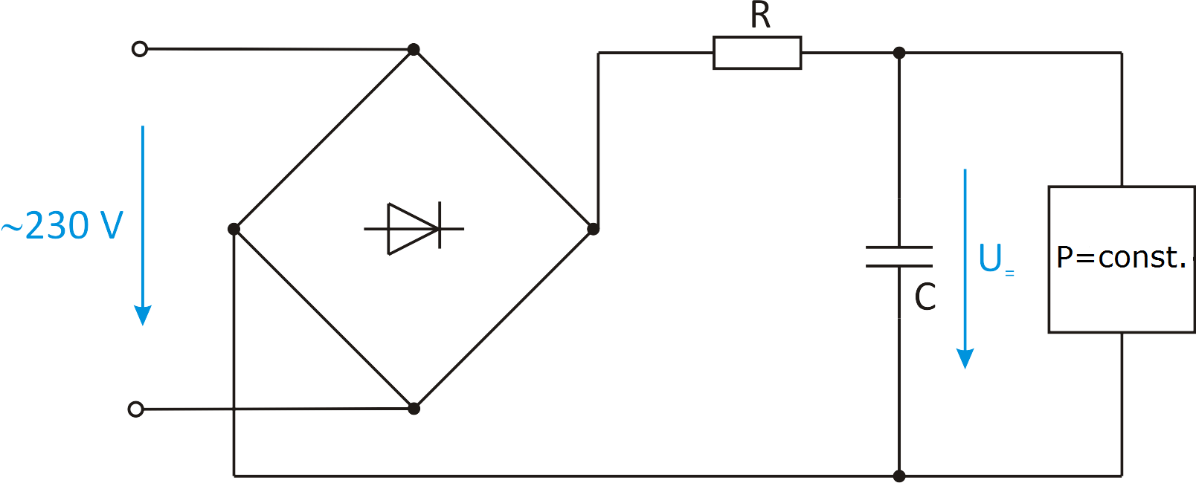
ESL Simulation Model
I=f(type ESL)
I=f(Uh)
I=f(ϕh)
Simplification to
bridge rectifier
smooth capacitor
„attenuation“ resistor
constant sink
parameters R and C for
different behaviour

Slide 7
Verification of ESL Simulation Model
Comparison for current of measurement (10 ESLs) and simulation (3 model parameter sets)
Verification of the dependency of harmonic currents on harmonic voltages e.g. I₇ on U₇

Slide 8
Development of the entire Simulation Model
ESL
Consumer load
LV Grid
specifications from real LV Grid
predistortion from MV Level
10%-15% other non-linear load
Comparison for total current of measurement and simulation of the LV grid without ESLs

Slide 9
Simulation Result (1)
  The simulated current at the feeder of the transformer shows
increasing 3rd and 9th harmonic current
decreasing 5th harmonic current

Slide 10
Simulation Result (2)
Vectorial addition for several harmonic currents caused by ESLs/customer and other non-linear load (NL)

Slide 11
Simulation Result (3)
  The simulated voltage at the end of the line (last customer) shows
increasing 3rd,7th and 9th harmonic voltage
decreasing 5th harmonic voltage

Slide 12
Simulation Result (4)
Influence of predistortion from MV level
on the resulting voltage in LV level in case of U₇

Slide 13
Summary
A significant spread of harmonic currents between different types of ESLs.
Magnitudes and phase angles of harmonic voltages in supply voltage have significant influence on the harmonic emission of ESLs.
Phase angles of harmonic voltages resulting from ESLs, other non-linear loads and predistortion from MV level play a vital role, how ESLs influences the power quality in the LV level.

