Slide 1
Cired Working Group ”Smart Grids”
Markus Zdrallek
Wuppertal University
Frankfurt, 9th of June

Slide 2
Scope of the WG
Give the wide field of “Smart Grids” structure and definition
Describe the need for applications of „Smart Grids“
Describe the „state of the art“ of smart technologies ?
Describe the „state of the art“ of standardization ?
Markus Zdrallek – Germany – RT 6b

Slide 3
CIRED WG Smart Grids - Members
Helfried Brunner, AIT, Austria
Roberto Calone, Enel Distribuzione, Italy
Yves Chollot, Schneider Electric, France
Dick Kronman, ABB, Finland
Pierre Mallet, ERDF, France
Carlos Mota Pinto, EDP Distribuição – Energia, Portugal
Holger Müller, Siemens, Germany
Dave Openshaw, EDF Energy, United Kingdom
Jarmo Partanen, Lappeenranta University of Technology, Finland
Fabrizio Pilo, University of Cagliari, Italy
Borja Thomas , Nexans Power Accessories, France
Markus Zdrallek, Bergische Universität Wuppertal, Germany (Chairman)
Markus Zdrallek – Germany – RT 6b

Slide 4
Main Time Schedule
CIRED Working Group on Smart Grids | 2011 |  |  |  |  |  |  |  |  |  |  |  | 2012
 | 1. Quarter |  |  | 2. Quarter |  |  | 3. Quarter |  |  | 4. Quarter |  |  | 1. Quarter |  |  | 2. Quarter
Data collection of running projects
Define/agree on main contents for WG/chapters of the final report
First physical meeting
Parallel work on the contents
Second physical meeting
Parallel work on the contents/writing the chapters of the final report
Third physical meeting
Finalizing the report
Presentation of the final report
Documentation
1
2
3
Markus Zdrallek – Germany – RT 6b
Physical meeting/milestone

Slide 5
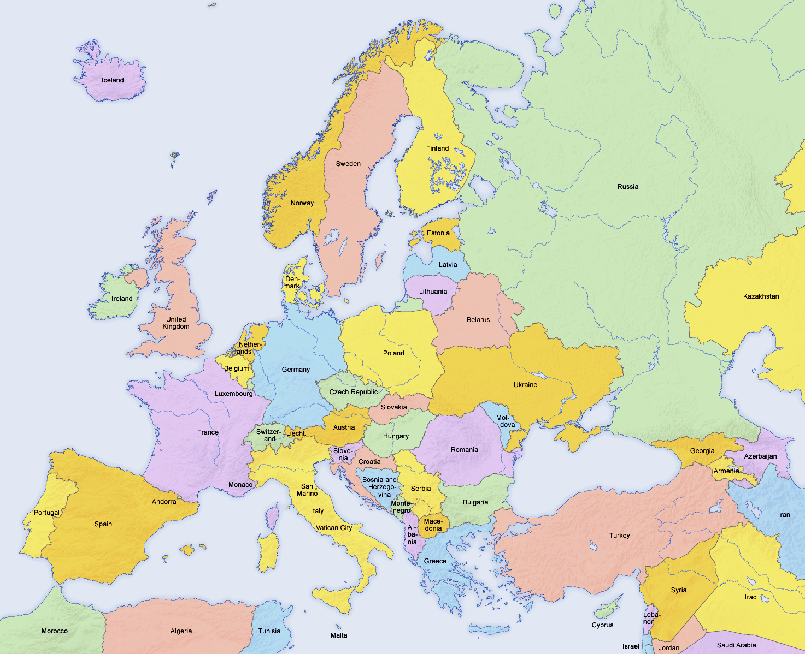
Smart Grid Projects across the EU
Markus Zdrallek – Germany – RT 6b

Slide 6
Categories of Smart Grid projects
CTRL | Control Techniques | ICT | Information and Communication Technologies
DATA | Datawarehousing | R+Q | Reliability and Power Quality
M+R | Energy Market and Regulation | RG+S | Renewable Power Generation and Energy Storage
GI | Grid Infrastructure | SM | Smart Metering
Markus Zdrallek – Germany – RT 6b

Slide 7
Working Group – First Results I
Main drivers/Need for Smart Grid applications
Integration of renewable energy/dispersed generation
E-mobility
Storage
Energy Market/Demand Site Management
Reliability/Quality of Supply
Two possible solutions:
Invest in primary equipment (cables, transformers etc.)
Invest (less!) in grid intelligence (secondary equipment)
Strong focus on MV- and LV-grids
Markus Zdrallek – Germany – RT 6b

Slide 8
Working Group – First Results II
Technical Solutions/State of the Art Technologies
Control Techniques
Central Control Systems
Decentralized Control Systems
Protection Systems
Communication Techniques
Communication Media/Carrier
Range/Area of Communication Techniques
New grid infrastructures, new grid planning principles (primary equipment/hardware)
Data Warehousing
International/European Standards/State of the Art in Standardization
Markus Zdrallek – Germany – RT 6b

Slide 9
Examples for Smart Grid Projects: eTelligence, Germany
CTRL
ICT
Marketplace
Smart Metering
Markus Zdrallek – Germany – RT 6b
Source: eTelligence project

Slide 10
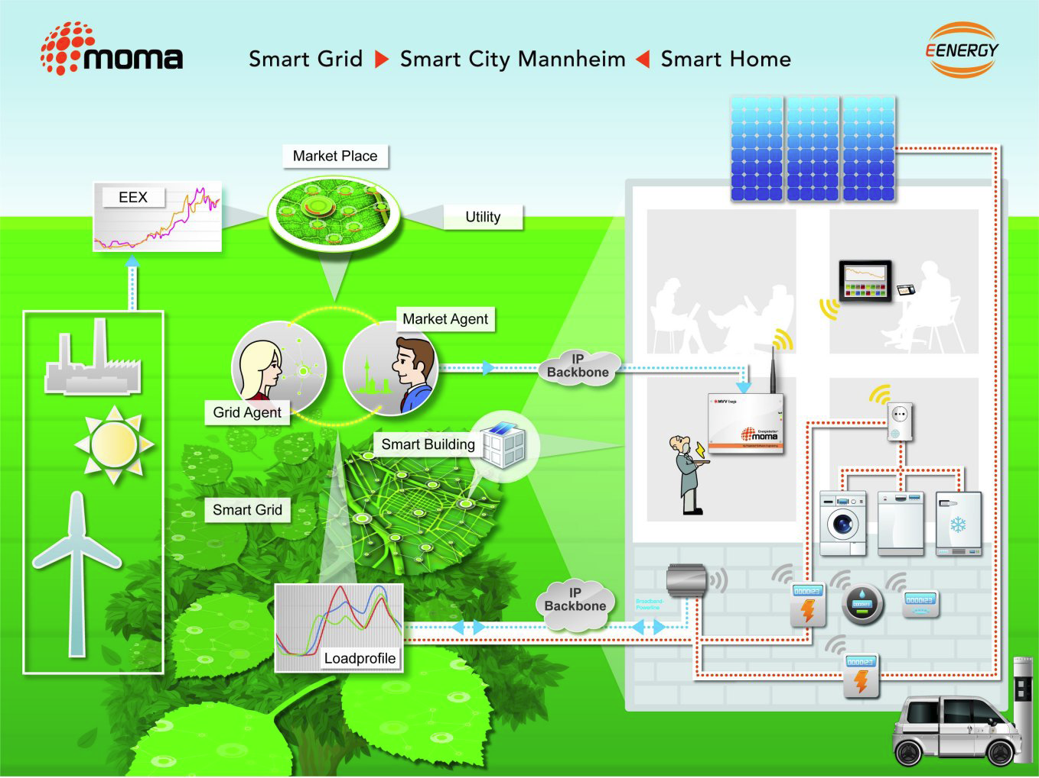
Examples for Smart Grid Projects: moma, Germany
CTRL
ICT
Marketplace
Markus Zdrallek – Germany – RT 6b
Source: moma project

Slide 11
Examples for Smart Grid Projects: AMI, Slovenia
ICT
Smart Metering
Markus Zdrallek – Germany – RT 6b
Source: AMI project

Slide 12
Examples for Smart Grid Projects: InovGrid, Portugal
CTRL
Marketplace
Storage
Renewables
Infrastructure
…
Markus Zdrallek – Germany – RT 6b
Source: InovGrid project

Slide 13
Contact data
CIRED WG Smart Grids
Markus Zdrallek, Chairman
Wuppertal University
Rainer-Gruenter-Str. 21 zdrallek@uni-wuppertal.de
42119 Wuppertal +49 202 439 1976
Germany
Christian Oerter, Assistant of the Chairman
Wuppertal University
Rainer-Gruenter-Str. 21 christian.oerter@uni-wuppertal.de
42119 Wuppertal +49 202 439 1014
Germany
Markus Zdrallek – Germany – RT 6b

